Slide 1

Tao Trio
Legend
of the
By: Cedric Juniper
Please bear with me I am NEW to this program

Slide 2
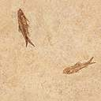
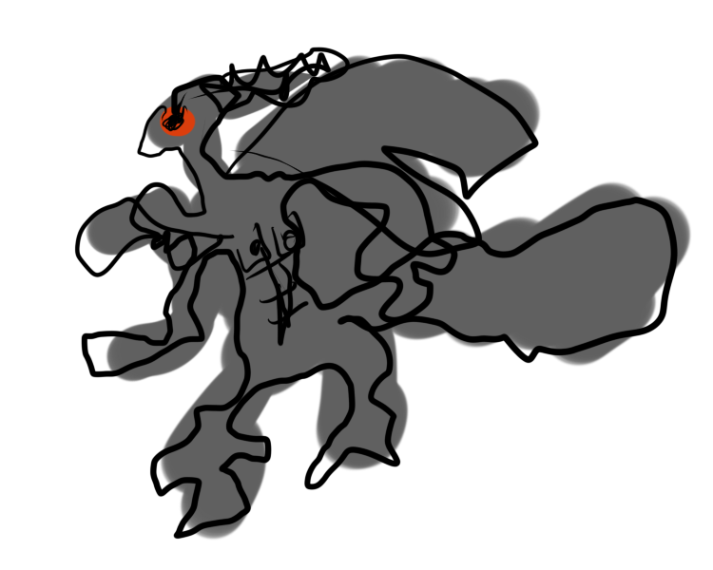
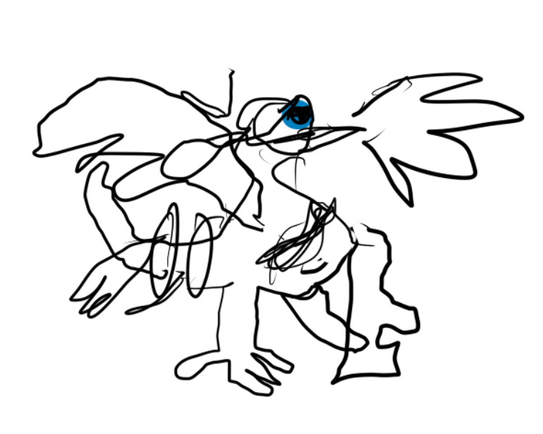
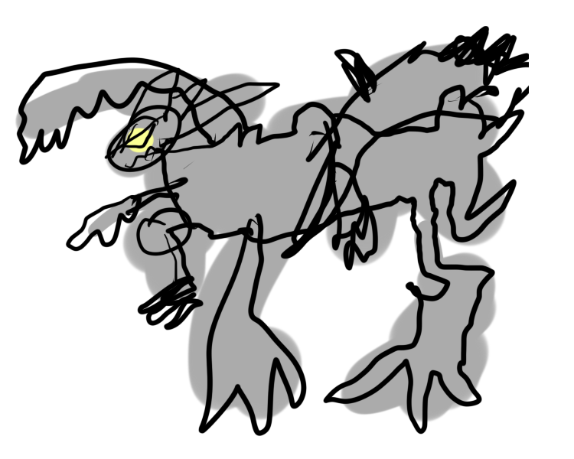
The Tao trio, sometimes called the Tao dragon trio or the energy trio, is the collective term used to refer to the three powerful legendary Pokémon of New York: Reshiram, Kyurem, and Zekrom.
P.S. drawing Pokémon is hard!

Slide 3

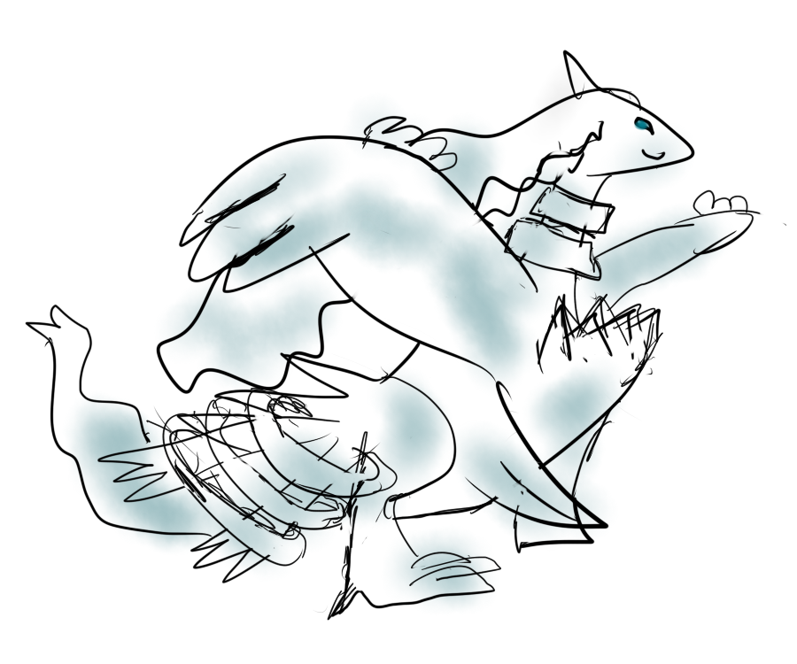
Zekrom and Reshiram are believed to have once been a single powerful Dragon Pokémon used by twin heroes in order to create New York. But the brothers each sought something different in life—truth for the older brother and ideals for the younger—and they began to argue, then fight, over whose side was right. The single dragon, in response, split into
two Pokémon: Reshiram, who sided with the
older twin, and Zekrom, who sided with the
younger twin.
You might be wondering what
these “truths” and
“ideals” were…

Slide 4
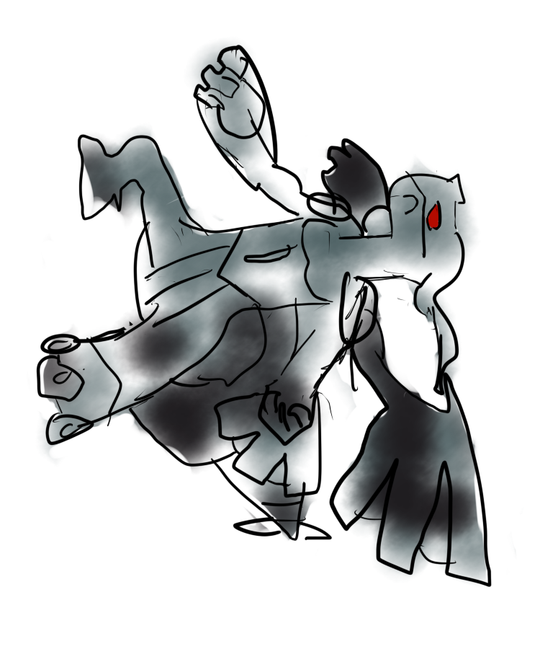
WELL, SO AM I!!!!
The two dragons were equally matched as they battled and neither conquered the other. As there was no victor, and there has yet to be one, the battle is destined to resume, presumably until only a single dragon stands.
What the brothers had fought over
so vehemently to cause an endless
war is currently unknown.
I sure hope it was something important!

Slide 5

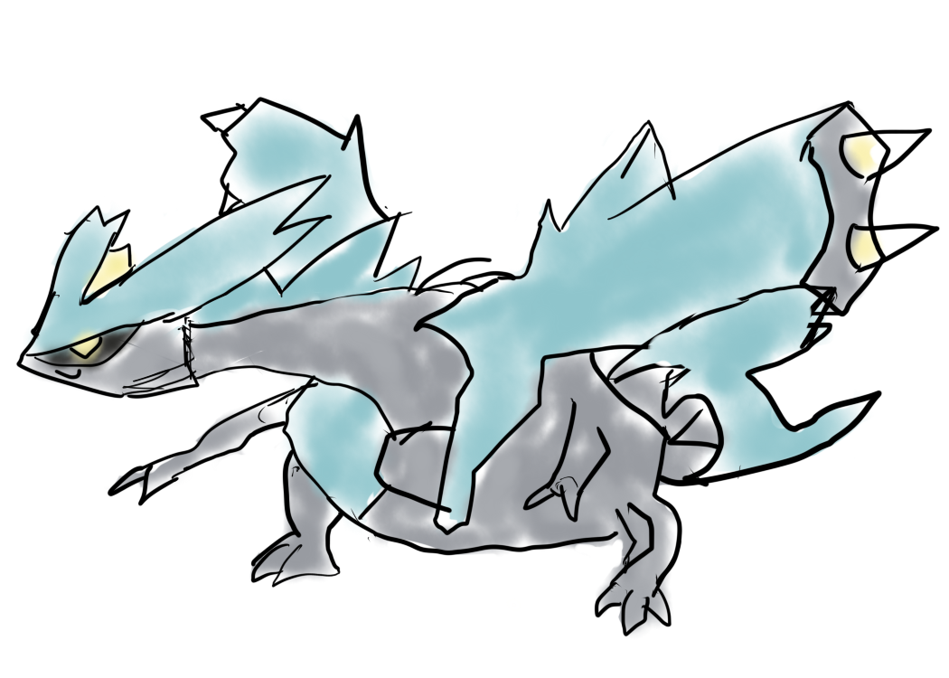
But What About Kyurem?
We can confirm the eating Pokémon and humans bit.
Kyurem's origins were believed to be much different than those of the other two. The third dragon came down from an icy meteor and crashed into a place called Giant Chasm. An old legend in Lacunosa Town describing Kyurem claims that it would take people and Pokémon away from the town and eat them.

Slide 6
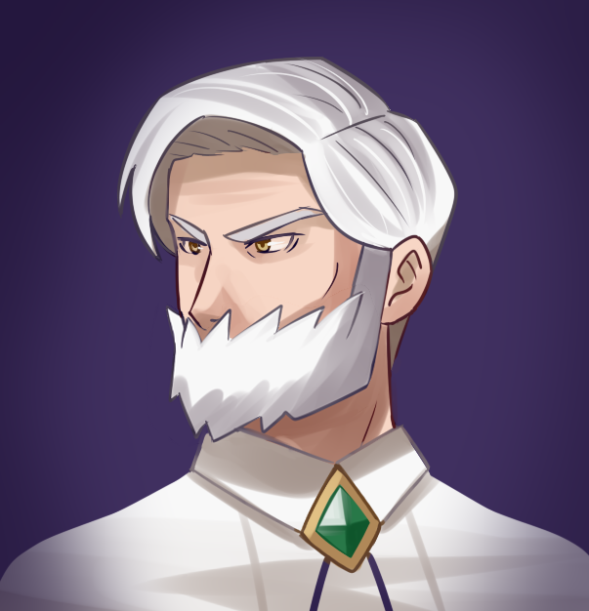
Drayden
Lacunosa Town’s legend implies Kyurem is not at all related to the other two dragons, and I find that difficult to believe! I spoke with Gym Leader Drayden, The Spartan Mayor of Opelucid City, and renown expert of Dragon-types, and he too believed that Kyurem must have a deeper connection with the other two. So he went straight to the source in search for answers. Yes, this means Drayden went over to the Giant Chasm to challenge Kyurem to a battle.
Why are humans so much easier to draw?

Slide 7
Drayden versus Kyurem
Kyurem’s power is believed to surpass that of the other two dragons; challenging it to a battle is the ultimate test of strength. Most trainers fall short and lose their lives to this dragon. But if anyone could defeat Kyurem, it would have to be Drayden.
Alas, Drayden could not completely subdue the dragon. But the battle ended with no casualties, which is an impressive feat in itself. As a reward, Kyurem did concede a bit of information about itself.
I’M SO PROUD OF THIS KYUREM DRAWING, I’M USING IT TWICE!

Slide 8


Kyurem’s Tale
When the original dragon split into Reshiram and Zekrom, a third dragon was "created", or "leftover": Kyurem. Kyurem also states that it is waiting for a Hero to fill in the missing parts of its body. Unlike the other two, Kyurem has had only had one Hero in its entire lifetime. Drayden is almost positive that Kyurem referred to this third Hero as female at least once, but Kyurem refused to speak more of the matter.
This one, too.

Slide 9
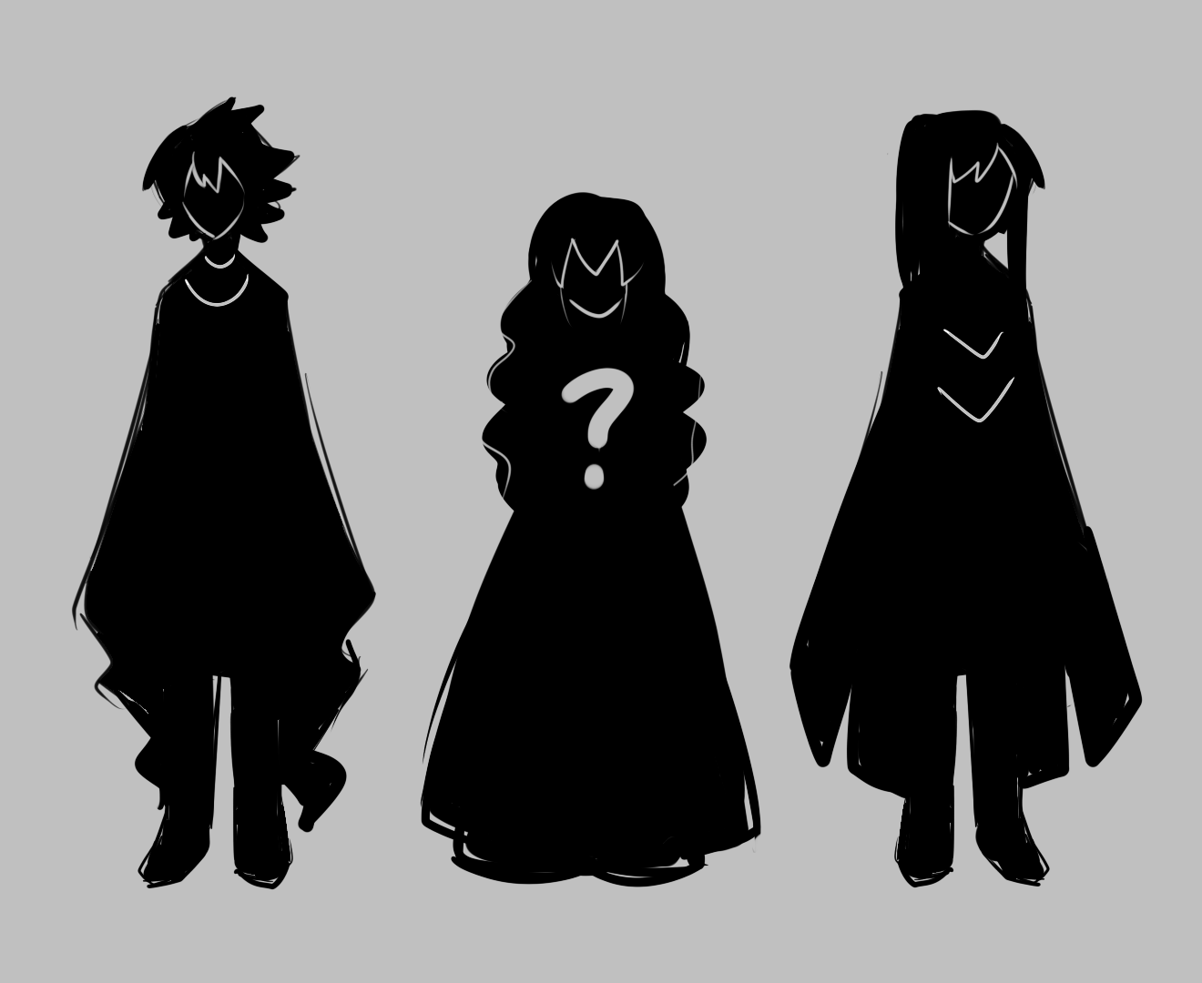
Ancient texts reveal that the Twin Brothers both had sons of their own, so one can assume they both had a female in their lives. Was there perhaps only one female? Was this the very same female that Kyurem chose as its Hero? Was she the reason they fought? Why is information on them so difficult to obtain? Unfortunately, all we can do for now is speculate.
Is it sad that I find it easy to believe that the endless cycle of death and destruction is due to two men fighting over a woman?

Slide 10
I ALMOST FORGOT! THE FOLLOWING IS TOP SECRET, AND ONLY A SELECT FEW CAN KNOW ABOUT IT. I’M TELLING YOU, BLACK, BECAUSE YOU SAID YOU WANT TO BE A HERO, AND I’M ROOTING FOR YOU! THE TWIN BROTHERS EACH POSSESSED A LEGENDARY ARTIFACT GIVEN TO THEM BY THEIR DRAGONS; THE LIGHT STONE FROM RESHIRAM, AND THE DARK STONE FROM ZEKROM. THESE ARTIFACTS ALWAYS FIND A WAY TO THE HANDS OF EVERY HERO EVER CHOSEN. THEY DISAPPEAR AT THE END OF EVERY BATTLE, ALONG WITH THE DRAGONS, AND THERE IS NO PATTERN AS TO WHERE THEY REAPPEAR, SO THEY ARE IMPOSSIBLE TO TRACK. THIS INFORMATION MUST NOT FALL INTO THE WRONG HANDS. PEOPLE WOULD WANT TO SEARCH FOR THESE ARTIFACTS IN HOPES OF BEING CHOSEN, BUT THEY WOULD MOST LIKELY JUST INTERFERE WITH THE DESTINY OF THE ACTUAL HERO. THERE ARE NO PHOTOGRAPHS OF THESE ARTIFACTS, SO NO ONE KNOWS EXACTLY HOW THEY LOOK LIKE. GOOD LUCK, AND KEEP TRACK OF EVERY PECULIAR STONE THAT CROSSES YOUR PATH!

Slide 11
Other Notes
Notable people Kyurem has battled in the past 50 years:
President Kennedy, 1963
Champion Alder, 1975
Leader Drayden, 2001
Leader Hachiku & Trainer Black, 2012
90+ others unaccounted for
Including Pokémon, an estimated 500+ deaths in the past five decades due to Kyurem
Reshiram and Zekrom’s previous battle is believed to have been in 1492.
Every time Reshiram and Zekrom battle, over 90% of this region’s population is wiped out!

